Slide 1
Introducing Azure Functions & Power BI Embedded
Will Eastbury & John Donnelly
Technical Evangelists

Slide 2
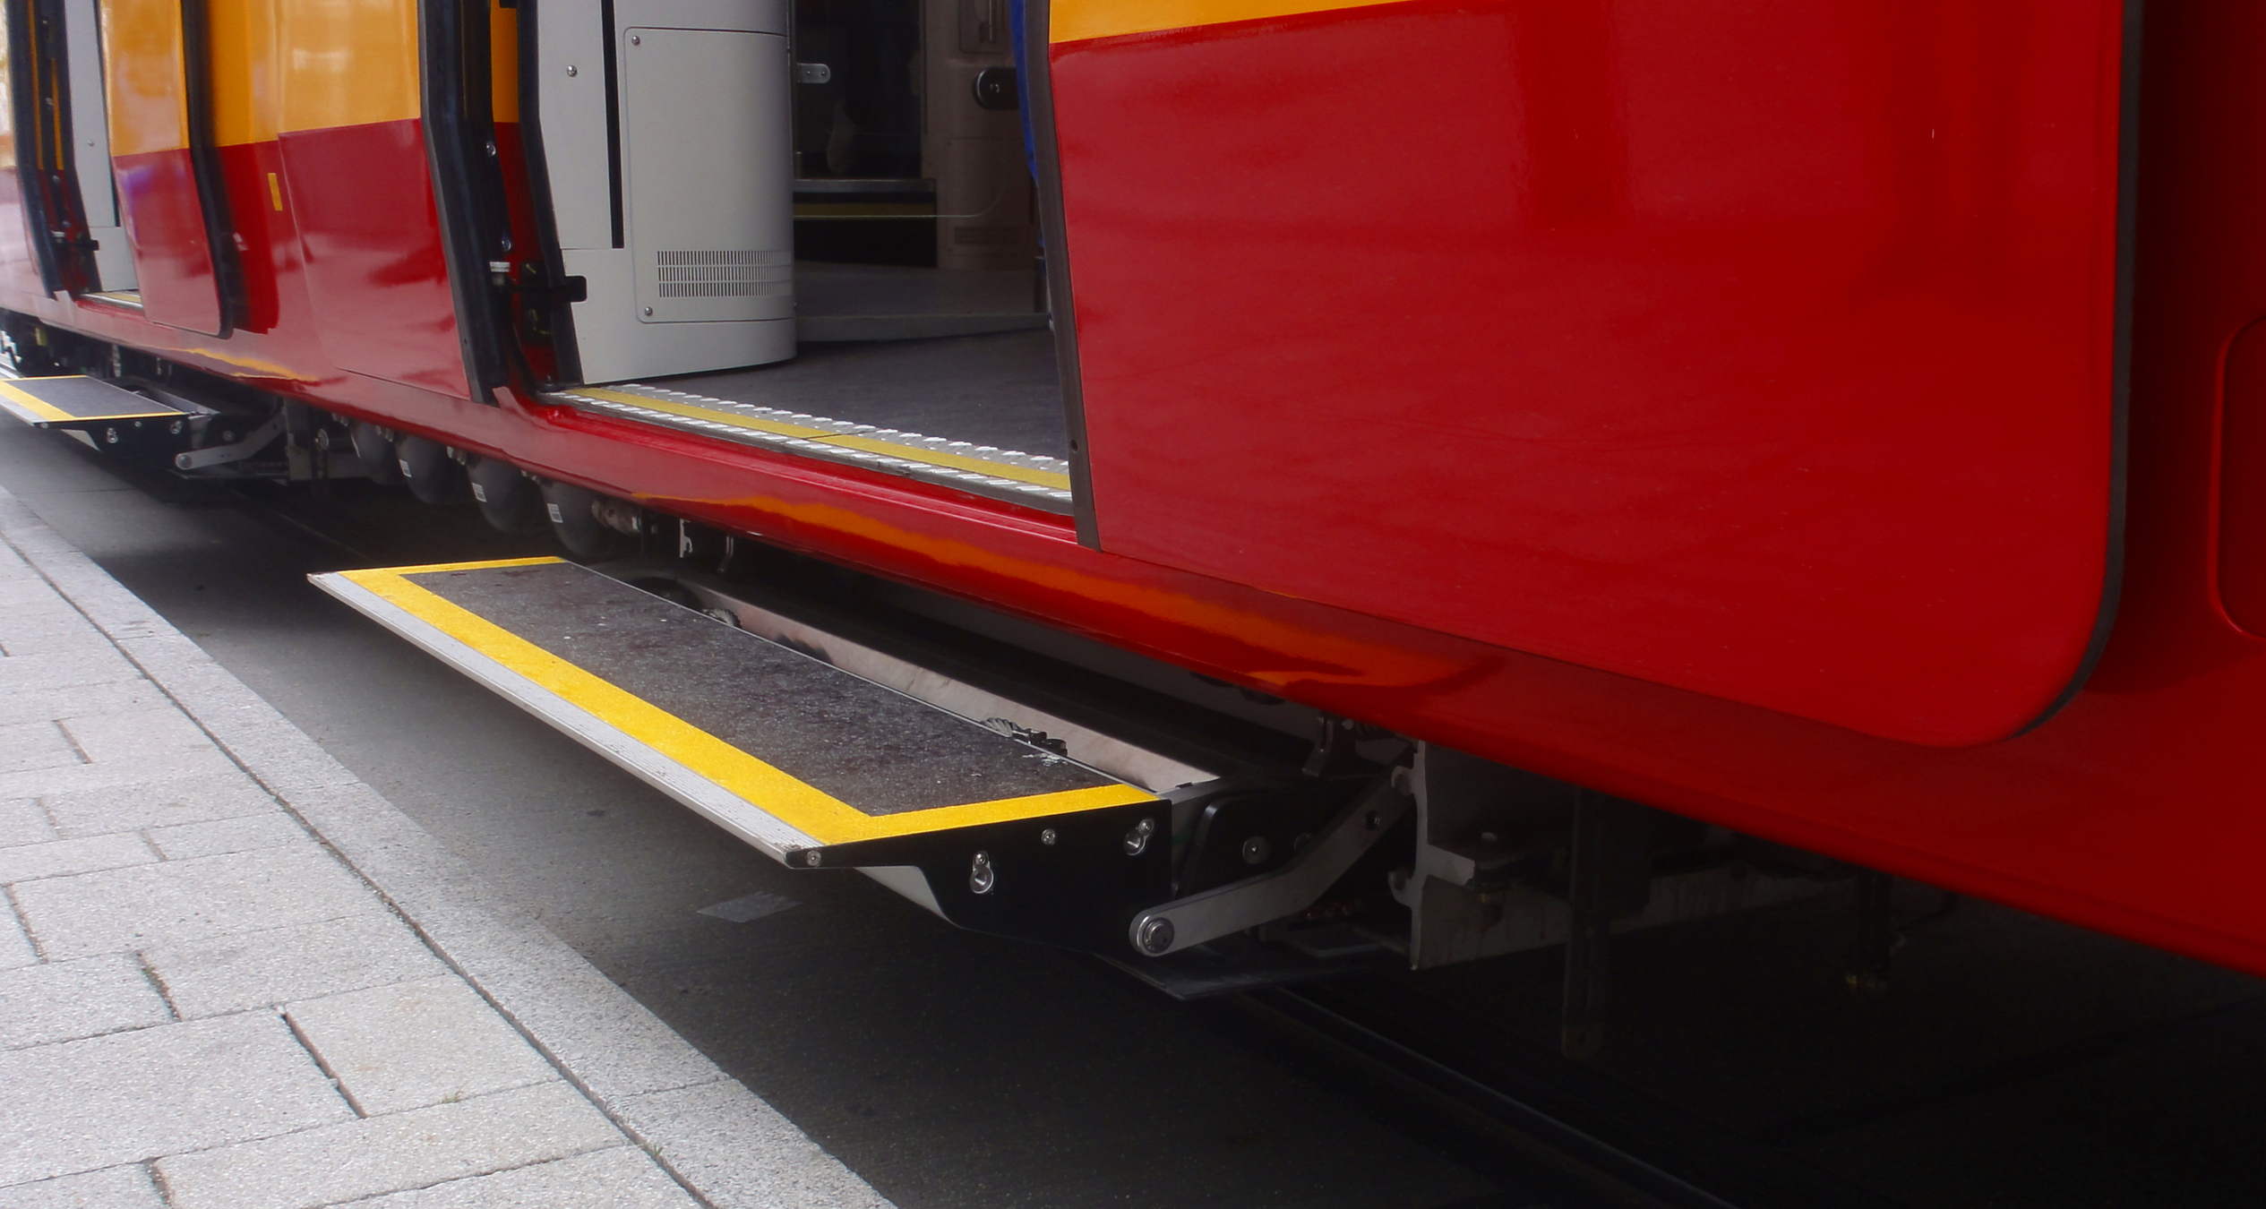
Mind the Gap !
Will Eastbury & John Donnelly
Technical Evangelists
Notes:
Background from :-
Licence http://artlibre.org/licence/lal/en/
User:nenntmichruhigip on Wikimedia Commons
https://commons.wikimedia.org/wiki/Category:Train_station_platform_gap_fillers#/media/File:ET2010_928_Trittstufe.jpg

Slide 3
Mind the Gap !
Will Eastbury & John Donnelly
Technical Evangelists
Notes:
Background from :-
Licence http://artlibre.org/licence/lal/en/
User:nenntmichruhigip on Wikimedia Commons
https://commons.wikimedia.org/wiki/Category:Train_station_platform_gap_fillers#/media/File:ET2010_928_Trittstufe.jpg

Slide 4
During organisations transition to software-as-a-service based charging models, we generally hear about two big problems …

Slide 5
A gap between how you charge for your service and how you are charged for consumption of cloud resources. A gap between your current revenue and your service’s potential value to customers.
Notes:
Talk to the contexts, clearly state that this is not always revealed in those exact terms, but usually there is a mismatch between the ISV marketing of commercial value and the sales / costing models of the organisation.

Slide 6
When we talk with organisations about these challenges, we generally hear from the following roles …

Slide 7
Introductions

Slide 8
Meet Germaine Procurement Director @YourCustomer
Notes:
Hello, I’m Germaine, and I’m the procurement director at YourCustomer Ltd.
My CIO doesn’t have additional internal delivery resource and doesn’t really care about this aspect of the business, I have a requirement on my desk, and your software could fill it. But I’m sceptical. I’ve seen a lot of money paid out for software on the basis of perceived future value. This value is so rarely delivered.
Sometimes the software fails during initial deployment. If it gets past that vendors promises of future development often fall short.
In future I will only pay for value as I can see it being delivered. Up front licences? Not on your nelly. Monthly subscription? Maybe. Ideally I only want to pay for actual value delivered. If it’s email, are you saving me from junk mail? If it’s back office product, what insight are you giving me to my business?

Slide 9
Meet Mo: Sales Director @ YouCo
Notes:
Monthly amount / 36 month amortization
+ Including Support costs

Slide 10
Meet Jo: CTO @ YouCo
Notes:
Hi, I’m Will – and what I got in the contract was :-
Undertaking to run our software platform as a fully managed service pending the launch of our new SaaS product.
We have plans to launch product X as a service, but they are under construction and we will have to adapt our existing offering to run it in the cloud for now, but we need to get it right for the future launch. Hence we will deploy an IaaS instance of our existing software until the new offering is ready. Lift and Shift.
I have no ops staff so I’m going to pass this to John’s team as they have operational and support staff, with experience of running service operations – from running our internal IT services.

Slide 11
Meet Jeff: CIO @ YouCo
Notes:
Hi, I’m Roger – and I just have been:-
I have a team that runs Exchange server for internal operations and provides desktop support. We don’t have a 24x7 support desk. We’ve never run an external support service.
We can’t really do this, we shouldn’t really do this.
But I can’t really say no either.

Slide 12
Facepalm

Slide 13
… what just happened ?

Slide 14
What just happened ? We took our ‘classic’ software Our Sales Director killed our margin We templated it We deployed it to IaaS We are now ISV ‘JAMs’

Slide 15
Internal Retrospective:
Notes:
Mo – Sales: We have a new revenue model which matches the consumer demand, and I can sell more of these.
Will - CTO: For the first 36 months, this model is significantly less profitable as compared to traditional software purchasing. But we plugged the gap till the launch of ProductXaaS. We had to make some operational tweaks to the existing package to run effectively in the cloud. But it runs.
John – CIO: I have additional strain and responsibilities on my team with no extra budget or resource. The hosting cost of this application is far higher than it needs to be.

Slide 16
Customer Retrospective:
Notes:
Mo: We delivered your service, on time, on budget and working.
Germaine: But you promised me all of these SaaS features.
Incremental updates
True Single Sign On
Cloud Integration
The service is sluggish at certain times (month end)
Reports take a very long time to run.
It takes a long time for you to deliver new features.

Slide 17
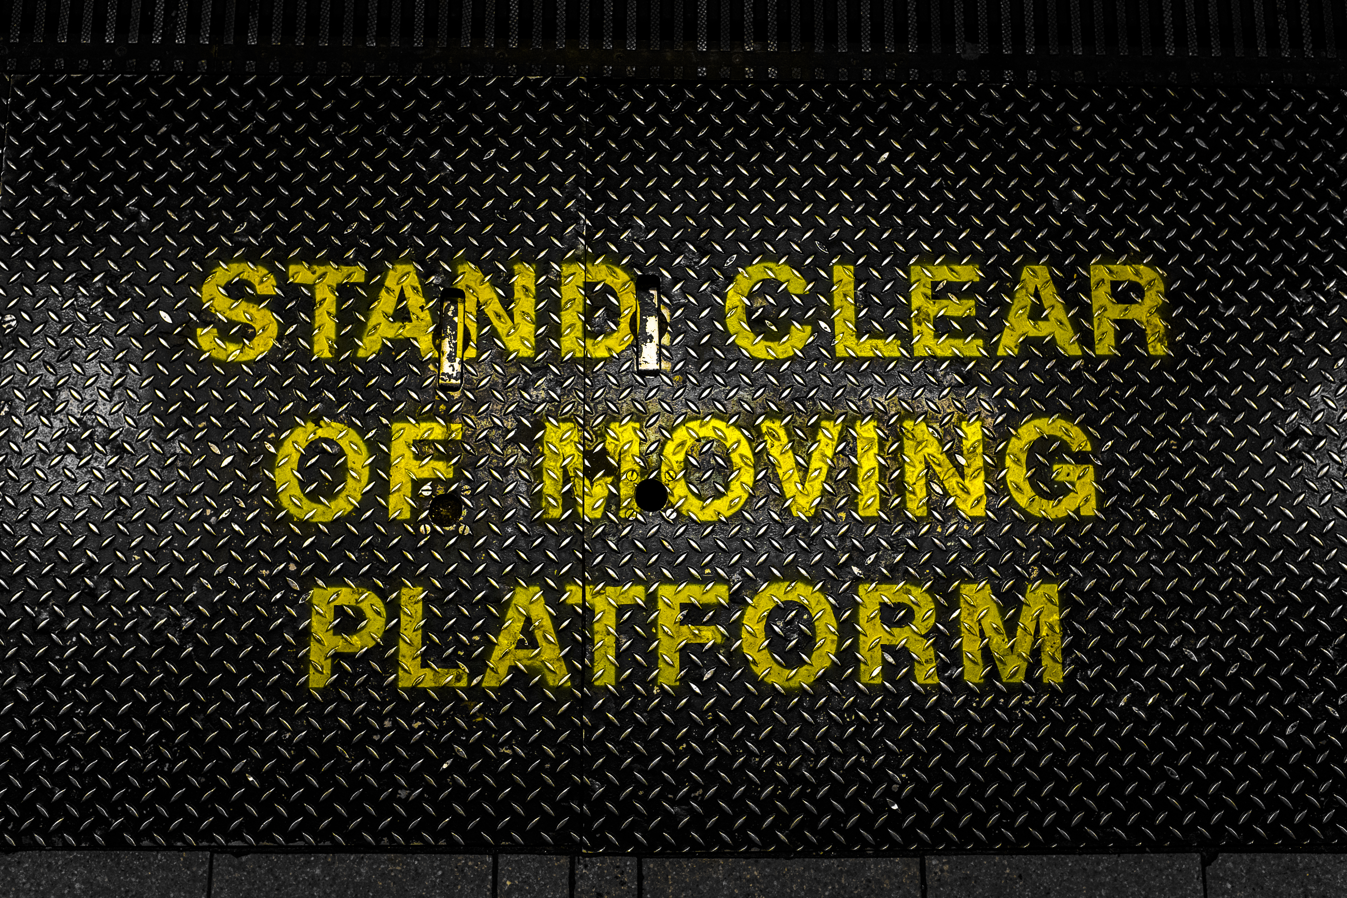
Right, I’ve sold a load more of these deals

Slide 18
Double Facepalm For when one Facepalm isn’t enough!

Slide 19
Gap 1. A gap between how you charge for your service and how you are charged for consumption of cloud resources.
Notes:
Price :- was a fixed price (1/32) of their licence fee, but didn’t incorporate service operating costs, only a support charge.
Cost of Service is largely fixed in an IaaS environment as you are usually running VM’s.

Slide 20
Gap 2. A gap between your current revenue and your service’s potential value to customers.
Notes:
Move to pricing based on business / consumer value, not on cost + markup.
You are not just reselling cloud, it is your IP that is valuable, that is what you are really selling to the end-customer, everything else is just plumbing, and your price should scale based on how much of that service / IP your customer consumes.
Once you do that – a serverless model where your costs scale based on how much of our services / IP you consume starts to make much, much more sense.

Slide 21

Looking forward – mind the gaps! Reduced customer time to return by 36 months. Extended ISV time to profit by 36 months. Added new risk of customer termination Added new risk of over-consumption (risk of under-pricing against fixed IaaS resource costs) – results in excessive cost or under-performance. Added new risk of under-consumption of resource (IaaS over-provisioning)
Notes:
So what really happened here ?
https://commons.wikimedia.org/wiki/File:Dangerous_Cliff_Edge_(2258425643).jpg
This file is licensed under the Creative Commons Attribution-Share Alike 2.0 Generic license.

Slide 22
How do we deal with these gaps?
With Coffee

Slide 23
Looking forward We SaaSify the app We deploy it to PaaS / Serverless We change the billing model We are now ISV Leaders in SaaS

Slide 24
Gap 1. A gap between how you charge for your service and how you are charged for consumption of cloud resources.
Notes:
Price :- was a fixed price (1/32) of their licence fee, but didn’t incorporate service operating costs, only a support charge.
Cost of Service is largely fixed in an IaaS environment as you are usually running VM’s.

Slide 25
Minding Gap 1 Align how you charge for your service with how you are charged for consumption of cloud resources.
Notes:
Price :- was a fixed price (1/32) of their licence fee, but didn’t incorporate service operating costs, only a support charge.
Cost of Service is largely fixed in an IaaS environment as you are usually running VM’s.

Slide 26
Costing Model Comparison
Notes:
In this model, the more money you pay to us, the more money you make, we are partners in your service.

Slide 27
But we know that service consumption isn’t really linear
Notes:
In this model, the more money you pay to us, the more money you make, we are partners in your service.

Slide 28
What do we mean by “Serverless”?

Slide 29
Serverless = You are not being charged for the runtime cost of a server directly.
The risk of under consumption (and hence wastage) of provisioned service transfers to the provider (Microsoft)
and away from the customer.
Don’t consume: Zero charge – The origin and barrier
to entry £Zero – or better than zero on ‘Consumption priced’ services that have a free tier.
Consume: Predictable charge so you can calculate a margin.

Slide 30
Services in Azure that can run on solely Consumption based pricing
Azure Functions
Azure Storage
Azure CDN
Azure Service Bus
Azure Event Hubs
Power BI Embedded
+ Many, many more
Notes:
It is possible to build sites and apps that run only on these services, to leverage consumption based pricing and build high-performance sites and apps that scale linearly and predictably, with costs that scale linearly and predictably.

Slide 31
So what’s the benefit, what’s the difference for me?
Predictable, per-transaction billing
Mass scale out with no incremental cost of provisioning
Cost origin that starts at zero
Free service whilst consumption is reduced or minimal
Notes:
Billed by runtime of transactions, pay truly upon usage, not ‘near to’ estimated / provisioned usage.
Forget about how many servers you need, only care about how many you transactions that want to charge for.
Want to bootstrap a service quickly, with minimal investment – serverless based plans are disposable.
Only pay for what you actually consume, let Microsoft take the risk and revenue hit of provisioning and reserving a massive pool of server hardware.

Slide 32
Why Azure Functions?

Slide 33

Azure Functions Demo
Notes:
Open portal and create a new Function App call it Demo12012017
OR open bash
func new functionApp myFuncApp
Highlight the different types of plan option and what they mean.
- The Consumption plan lets you pay-per-execution and dynamically allocates resources based on your app's load.
- App Service Plans let you use a predefined capacity allocation with predictable costs and scale.
Choose the serverless plan.
Create a new C# Http Function with function auth and call it BillingTelemetry
Add this code….
using System.Net;
public static async Task<HttpResponseMessage> Run(HttpRequestMessage req, TraceWriter log)
{
// parse query parameter
string module = req.GetQueryNameValuePairs().FirstOrDefault(q => string.Compare(q.Key, "module", true) == 0).Value;
string tenant = req.GetQueryNameValuePairs().FirstOrDefault(q => string.Compare(q.Key, "tenant", true) == 0).Value;
string feature = req.GetQueryNameValuePairs().FirstOrDefault(q => string.Compare(q.Key, "feature", true) == 0).Value;
log.Info($"{DateTime.Now.ToString()}|{module}|{tenant}|{feature}");
return req.CreateResponse(HttpStatusCode.OK, $"Logged a login from {module}|{tenant}|{feature}");
}
-- Show the bindings in the gui.
Run the function by hitting from a web browser
https://demo12012017.azurewebsites.net/api/BillingTelemetry?module=Main&tenant=willeastbury&feature=logon&code=2aC91aH/Pa3LzoBfb5/viSKSfceQo1FLTB2FEtMJIV4jjm4/HpO9Hg==
Do the same for a PowerShell http function
$requestBody = Get-Content $req -Raw | ConvertFrom-Json
$d = (get-date)
Write-Output "$d| Logged a login from $req_query_module|$req_query_tenant|$req_query_feature“
https://demo12012017.azurewebsites.net/api/HttpTriggerPowerShell2?code=2aC91aH/Pa3LzoBfb5/viSKSfceQo1FLTB2FEtMJIV4jjm4/HpO9Hg==&module=test&tenant=test2&feature=test34
If time left over then go to devroot on kudu and show app service editor….
https://demo12012017.scm.azurewebsites.net/dev/wwwroot/HttpTriggerCSharp1/function.json
Or…. Bash …. sudo npm install -g azure-functions-cli

Slide 34
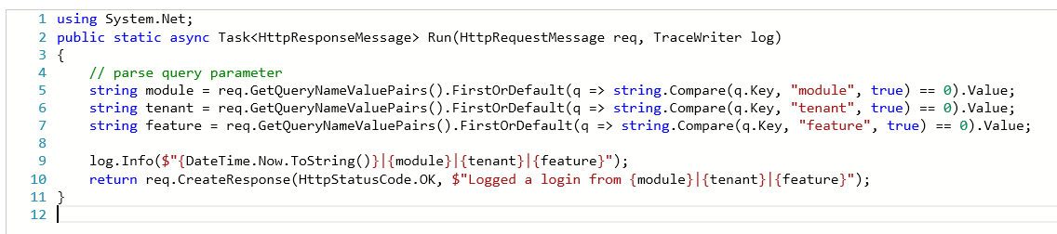
My Function code C#
\BillingTelemetry\Run.csx

Slide 35
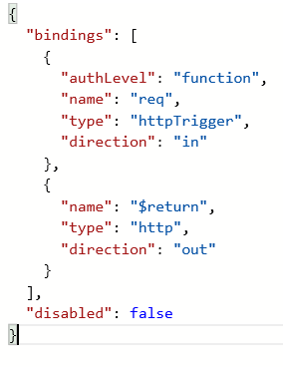
My Function code - PowerShell
\BillingTelemetry\run.ps1
\BillingTelemetry\function.json

Slide 36
Gap 2. A gap between your current revenue and your service’s potential value to customers.

Slide 37
What is the ‘Freemium’ model and what does it mean for my customers?
Free tiers > Premium tiers – “The first hit is free”
Multi-tenancy: != Lots of small accounts with free usage
You can now bill your customers directly based on tx consumption / overages above a free tier –
because that’s how you can opt to be charged.

Slide 38
‘Land and Expand’
Or … “How can I make more money from my customer base by adding more value to their business?”
What happens if I add additional complementary services that have an additional charge to my suite of products ?
Pricing by value. If a report can save my business £100,000, how much would I pay for it?

Slide 39
What constitutes ‘extra value’ and what will people pay for it ?
Why does the consumer need and / or want your service(s)?
What are they doing with your service?
Where is the additional value that you can unlock for them?
Are there insights you can unlock in their data, are there trends and patterns that you can see for them and let them harness inside their business?
Can you use AI to augment their staffs skill set and assist them to make intelligent decisions they can’t do without you?
Notes:
** Talk about ApplicationInsights and OMS Log Analytics here **
As well as AI.

Slide 40
Shifting to value based consumption and billing
Notes:
In this model, the more value we deliver, the more money your customer pays to you, the more money you pay to us, the more money we both make, we are delivery partners in your service.

Slide 41
Minding Gap 2 Align your pricing so it represents a slice of the value gained by the customer for each transaction.
Notes:
Move to pricing based on business / consumer value, not on cost + markup.
You are not just reselling cloud, it is your IP that is valuable, that is what you are really selling to the end-customer, everything else is just plumbing, and your price should scale based on how much of that service / IP your customer consumes.
Once you do that – a serverless model where your costs scale based on how much of our services / IP you consume starts to make much, much more sense.
Align your pricing strategy to business value to customers and charge as this is delivered.

Slide 42
Power BI to Power BI Embedded
Notes:
What happens with reports that run 24x7 ?
Discuss, contrast and compare Power BI and PBI E.

Slide 43
Power BI Embedded Demo

Slide 44
Align your pricing so it represents a slice of the value gained by the customer for each transaction
Recap: Minding the Gaps
Design your costs so they are aligned to and scale by the number of transactions billed, not servers utilised.
Notes:
Background from :-
Licence http://artlibre.org/licence/lal/en/
User:nenntmichruhigip on Wikimedia Commons
https://commons.wikimedia.org/wiki/Category:Train_station_platform_gap_fillers#/media/File:ET2010_928_Trittstufe.jpg

